Slide 1
Earth Observations and Sustainable
Development Goals
Rick Lawford
August 28, 2012

Slide 2
The MDGs are a very useful concept because they focus nations and Aid Agencies on
achieving goals that benefit their people and they require regular accounting.
Although some may say they were too ambitious (and hence had little
chance of success) in one area (Provision of access to clean water)
the 2015 goal has already been met.
The MDGs had several limitations:
Nations appeared to be the sole arbitrators as to how well they were doing
in achieving a goal. The accuracy of the numbers they provided were sometimes
questioned (mainly by environmentalists).
2) The Earth Observation Community found it difficult to provide more than
indirect information in the evaluation of the achievement of the goals. This
came from the way in which the goals were defined.

Slide 3
Examples of questions that could be a basis for SDGs:
How quickly are countries using up their natural and physical
resources?
What is the cost of economic growth on the living environment
(pollution, health, living standards, etc.)?
Is the health of ecosystems improving or degrading?
What are the trends is ecosystem services from important
elements of the environment?

Slide 4
Q1. The terms MDGs, SDGs and Global Sustainability Goals have been used quite
loosely and inter-changeable in the discourse on the post-2015 development
framework. Are the three terms similar, different, complementary or conflicting?
And what are the implications for setting goals, targets and indicators and the
data needs?
Viewpoint: The terms will be interchangeable if the CSD (or whomever decides)
determines that they should be interchangeable. At present MDGs are well known
and SDGs are still being defined. The relationship between SDGs and MDGs
needs to be worked out.
Keeping SDGs and MDGs separate may be to the advantage of Earth Observations.
MDGs were defined in terms of societal impacts which promoted action but
sometimes made it difficult for EO to make substantive contributions. If SDGs are
defined in terms that are more quantitative in relation to measureable quantities
then EO will be able to make a better contributions in terms of defining
trends and progress.

Slide 5
For MDG “improve access to clean water”: What is measured and what not?
All water sources
Improved sources (measured)
Affordable
Good quality
Well regulated systems
Climate resilient
Sufficient quantity
Sustainable
Piped/household connection
(Courtesy of Rifat Hossain)

Slide 6
Q2. The world is getting much more closely inter-connected and inter-dependent;
therefore most of the goals and targets are inter-linked. How can we develop goals,
targets and indicators in a manner that acknowledges these inter-connections—
some complimentary and others with trade-offs? Do we and can we develop a
conceptual framework that might capture these system dynamics and identify
the data information required?
Viewpoint: While the observations about interconnectedness are very
true we need to walk before we run. If we can’t develop effective goals,
targets and indicators for water, for example, in ways that allow us to apply our EO
measurement, analysis and modeling capabilities in an effective way (MDGs)
how will we do it for SDGs unless we develop more focused SDGs to which we
can contribute.
That said, there is something useful in having a grand vision that shows all the
linkages and indicates the level of integration we are seeking. Furthermore it
would be useful to have individual SDG contributions that serve as building
blocks in the grand vision.

Slide 7
Q3. How do we develop global goals, targets and indicators that capture explicitly the
need for collective action to achieve these targets and how do we resolve the dichotomy
between the principle of universality and the principle of subsidiarity and its
implications for data collection?
Viewpoint: This is a good question. Where does the human element and
subjective opinion enter? To achieve the goals we need to engage different
levels of society. The MDGs engaged governments and international agencies.
Is this enough? To what extent do we wish to engage communities and allow
solutions to emerge from the individuals and groups of individuals?
The need for universality is clear in conventions and laws. It imposes a requirement
for standardization on an global basis. This is a natural niche for using
satellite data and we support it.
However, we also need to ensure the dignity of the individual and
the sovereignity of nations. This does not mean that we let everyone collect their
own data in their own way. We are constrained to have standards so there is
compatibility between data sets and interoperable data systems. However we also
need to ensure that societies have access to all the information that is available about
their countries and concerns so they can input to the discussion, achievement and
monitoring of SDGs in an effective way.

Slide 8
Q4. How will spatial and temporal scales across the natural and socio-economic sciences
impact the development of a post-2015 development framework and how will this
influence the data and information needs? For example, how will data on global
environmental indicators as suggested by planetary boundaries reconcile with local,
national and regional environmental indicators and subsequently the link with the
socio-economic targets, and indicators?
Viewpoint: Scale is becoming less of an issue for data on natural and physical systems.
The combination of data, data assimilation systems and models are moving to finer and
finer scales. The capabilities of large centralized systems exceeds what most individual
nations can undertake. The integration of these outputs over the scale of a nation or
a regional is very feasible. Models allow us to generate variables that cannot be
measured and to combine socio-economic data with physical data in innovative ways.
The planetary boundaries do provide us with a starting point and perhaps
we should assess how well we could support SDGs in the areas of these
boundaries recognizing that they may not be complete.

Slide 9
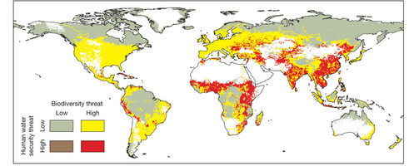
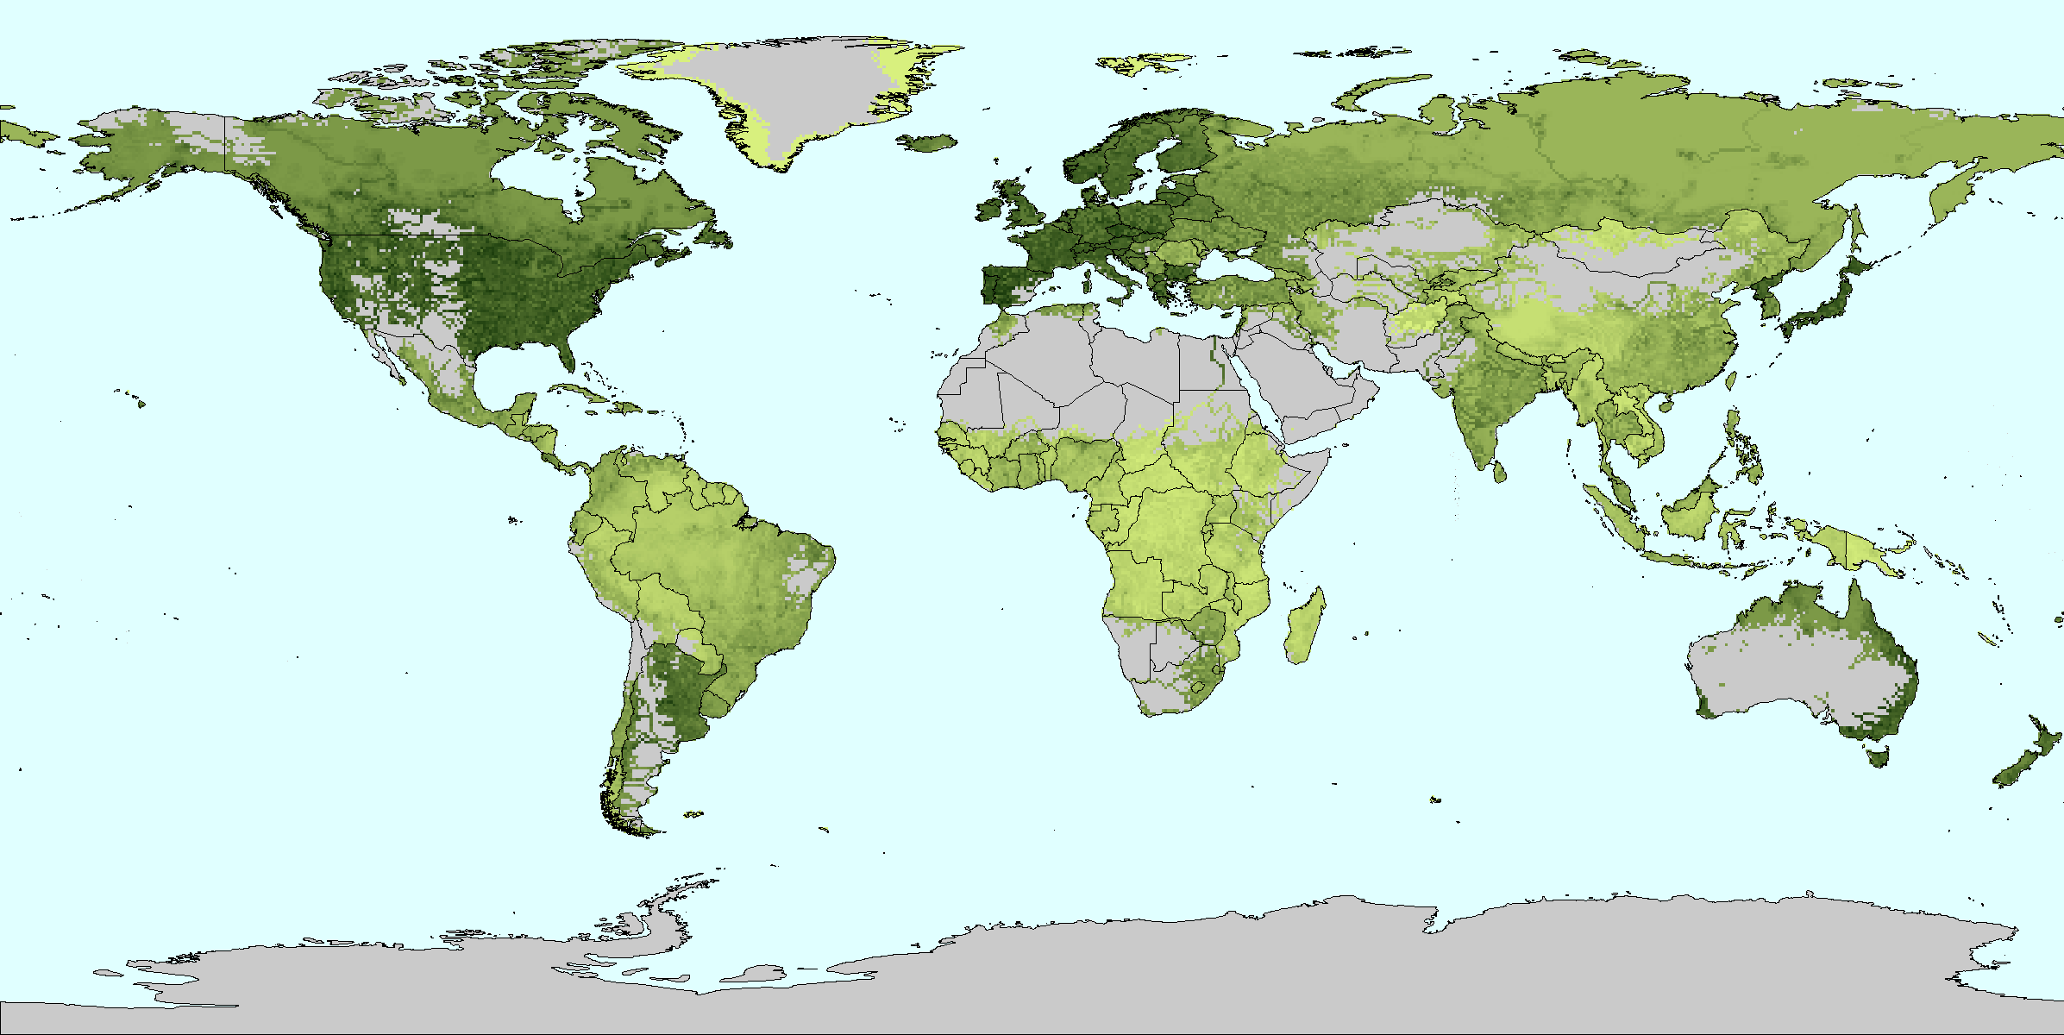
Global distribution of investment in human water security
Water security: „money (and technology) can buy“
(after C. Vorosmarty)
Models using socio-economic data tend to be limited by the resolution of that data

Slide 10
Q5. What will be the main challenges in reconciling the data and information needs
from the natural and socio-economic systems to ensure comparable concrete,
quantifiable and time bound goals, targets and indicators?
The main challenges:
Observations will not be at the same scale or at the same times. For example,
Census data may be available every five years. It is difficult to integrate this
information with five years of daily observations of temperature (for example)
because the one value is an integrated value while the other captures all the
variability over the five years.
In the case of physical variables the relationships are quite well known or at
least the laws that govern those relationships are well known. In the case of
socio-economic data it is necessary to separate the random connections from
the causal ones so modeling can take place.
Although environmental indicators have been available for many years they have not
been widely used because of the difficulty of getting information from
developing countries. Satellite observations (combined with models) are giving us
tools for addressing these problems.

Slide 11
Q6. What will be the main steps for the scientific community to take in order to
contribute to the post-2015 development framework process initiated by the UN?
Some steps could be:
To hold a workshop/conference with the development community
to discuss their needs for indices and to demonstrate our ability to produce indices
in areas such as climate trends, biodiversity and water status monitoring.
2) To launch the preparation of a highly visible white paper on the ways in which we
can inform the process on the development of SD goals and indicators.
3) To ensure that some members of our community become members of the working
groups supporting the bodies that are developing the post-2015 goals.
4) To provide capacity building in countries so they will be able to understand the
EO data and the tools that will be developed to translate them into indices.

Slide 12
We also need a shift in the way we evaluate progress:
Committee tallies the results from nations
and decides if the goal has been met or not
National reports on the number of people who have reached the new goal
Nations invest in infrastructure
And services so more people

Slide 13
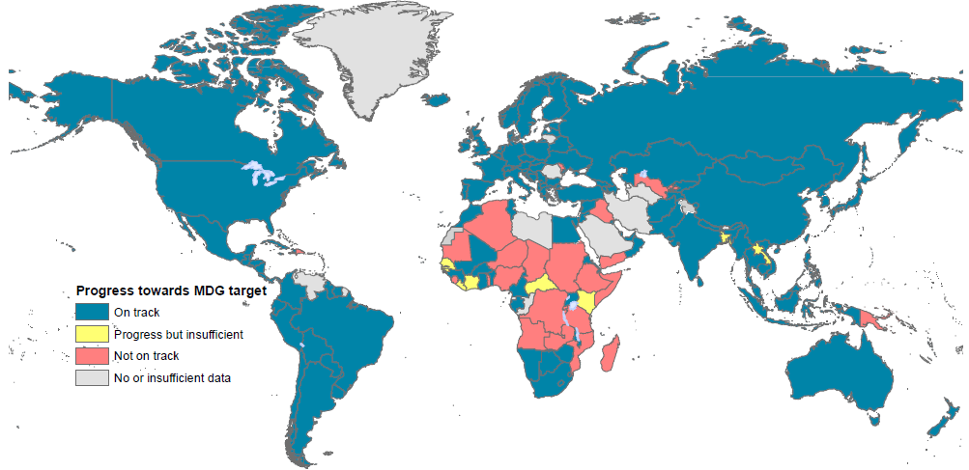
Example of an update on the Access to Water MDG. Recently it has been announced that this goal has been achieved.
(Courtesy of Rifat Hossain)

Slide 14
Committee tallies the results from nations
and decides if the goal has been met or not
National reports on the number of people who have reached the new goal
SD “group” provides independent
assessment of the progress towards
goals based on EO indicators
Nations invest in infrastructure
and services so more people can
Have services or benefits

